Slide 1

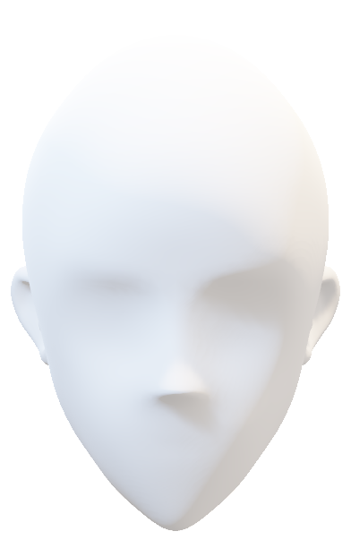
O U T L I N E
K I N E S I C S

Slide 2

O U T L I N E
K I N E S I C S
GROUP 7
Ridhima Arora – M23BBAU0162 (Research on Kinesics Cues)
Shubham Kumar – M23BBAU0163 (Research on Cultural differences in Kinesics)
Suryansh Raj Patel – M23BBAU0164 (PPT Idea & Design, Graphics, minor research about Overview of Kinesics)
Utkarsh Kumar – M23BBAU0165 (Research on Categories of Kinesics)
Anwita Chauhan – M23BBAU0166 (Team Leader/Management, Data Compilation)
Bhavya Gupta – M23BBAU0167 (Research on Need of Kinesics)
Uday Kapoor – M23BBAU0168 (Research on Categories of Kinesics)

Slide 3


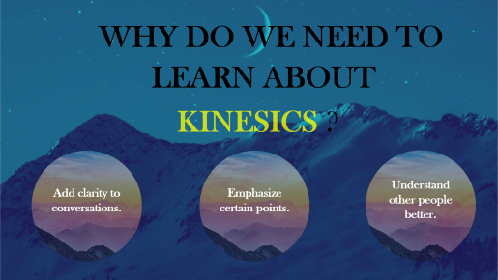
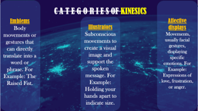
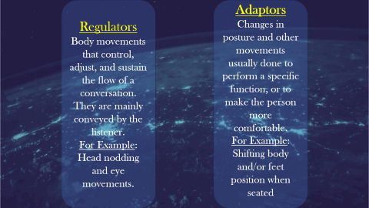
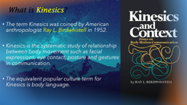
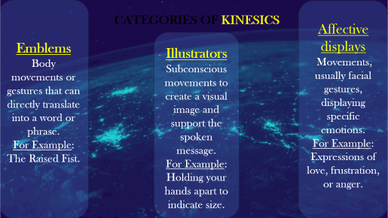
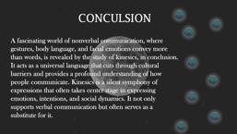
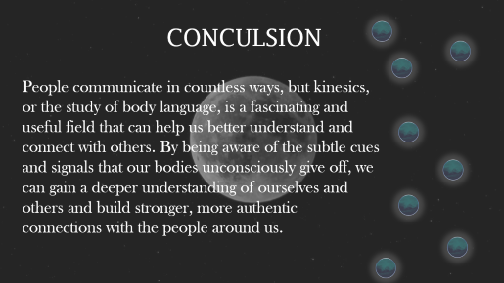
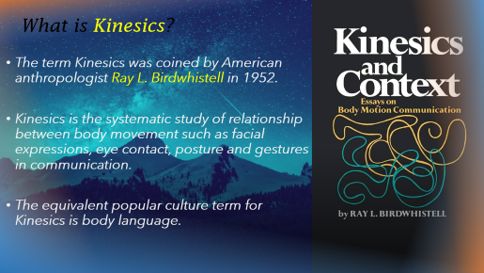
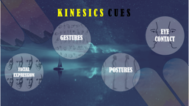
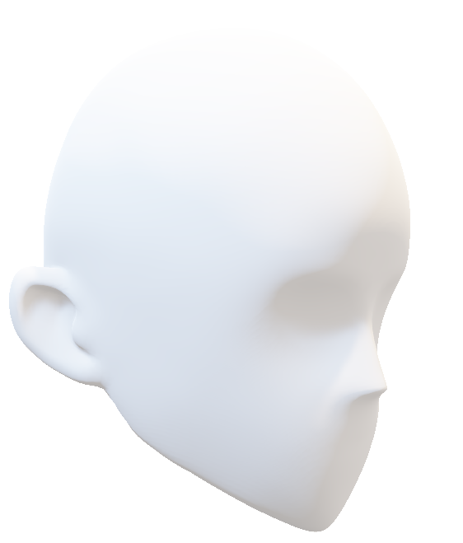
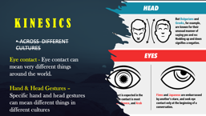
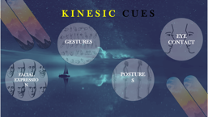
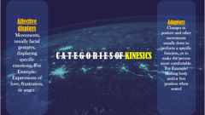
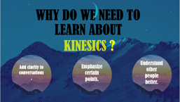
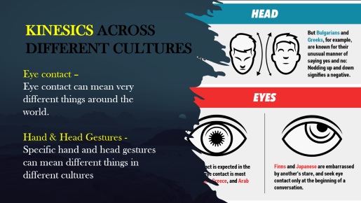
K I N E S I C S
O U T L I N E

Slide 4

K I N E S I C S
O U T L I N E

Slide 5

K I N E S I C S
O U T L I N E

Slide 6

K I N E S I C S
O U T L I N E

Slide 7

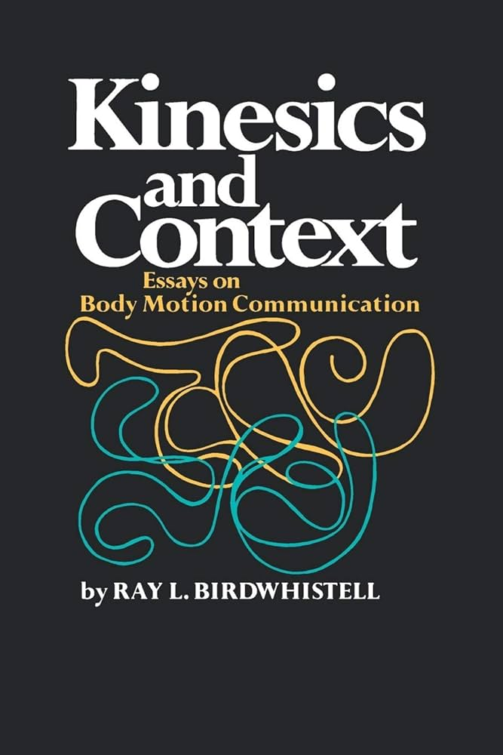
What is Kinesics?
The term Kinesics was coined by American anthropologist Ray L. Birdwhistell in 1952.
Kinesics is the systematic study of relationship between body movement such as facial expressions, eye contact, posture and gestures in communication.
The equivalent popular culture term for Kinesics is body language.

Slide 8



WHY DO WE NEED TO
LEARN ABOUT
KINESICS ?
Add clarity to conversations.
Emphasize certain points.
Understand other people better.

Slide 9

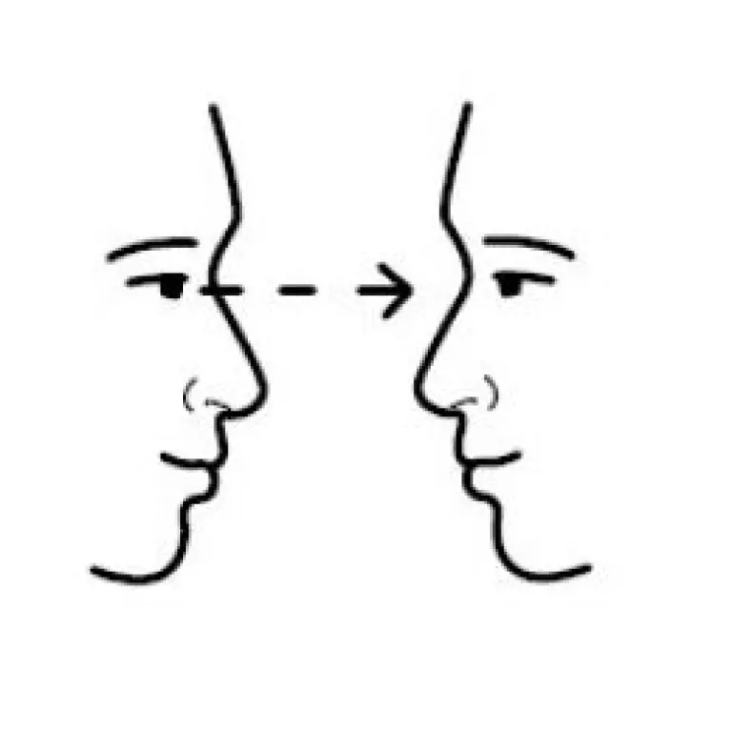
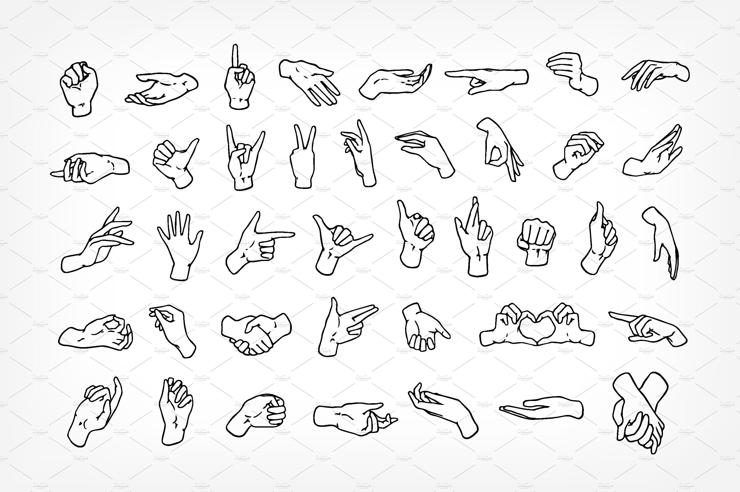
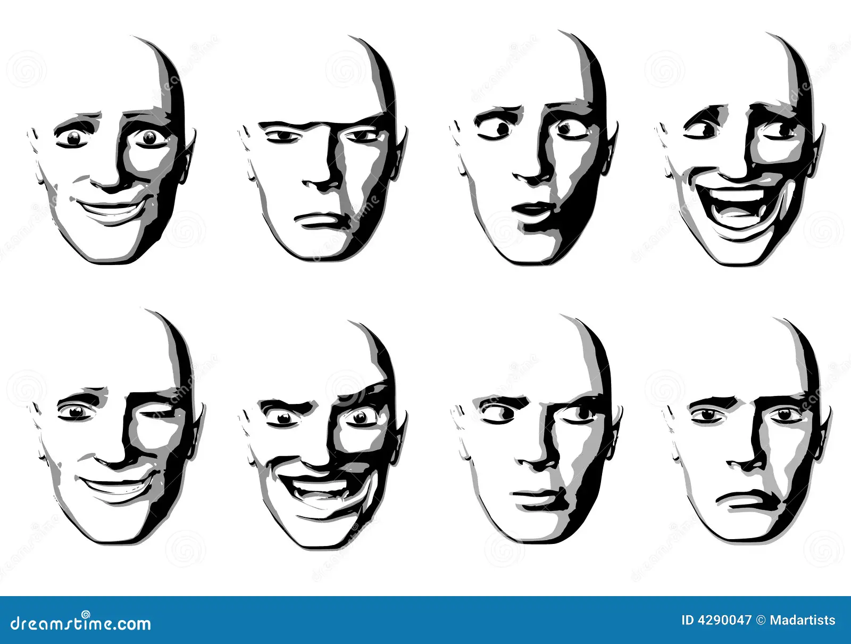
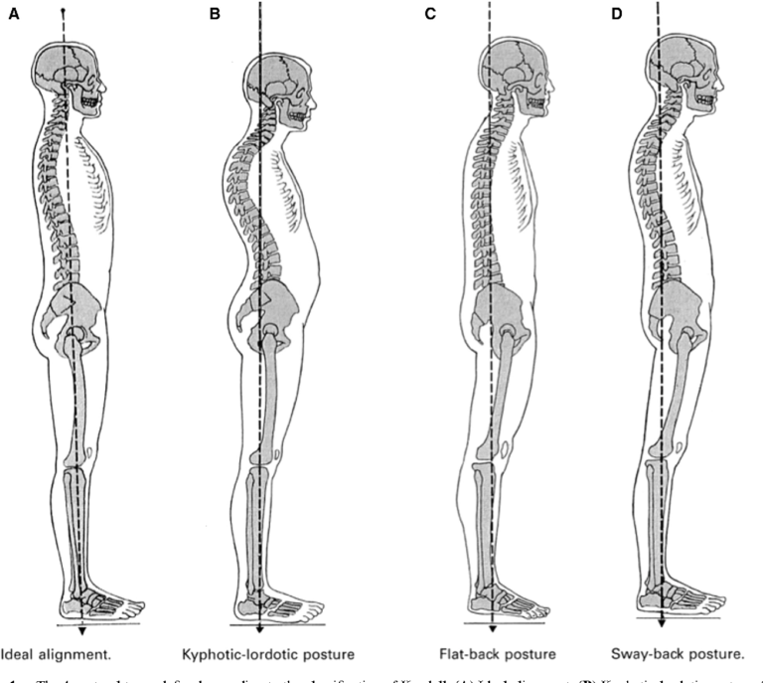
K I N E S I C C U E S
EYE CONTACT
GESTURES
FACIAL EXPRESSION
POSTURES

Slide 10

Emblems Body movements or gestures that can directly translate into a word or phrase.
For Example: The Raised Fist.
Affective displays
Movements, usually facial gestures, displaying specific emotions.
For Example: Expressions of love, frustration, or anger.
CATEGORIES OF KINESICS
Illustrators Subconscious movements to create a visual image and support the spoken message.
For Example: Holding your hands apart to indicate size.

Slide 11

Regulators
Body movements that control, adjust, and sustain the flow of a conversation. They are mainly conveyed by the listener.
For Example: Head nodding and eye movements.
Adaptors
Changes in posture and other movements usually done to perform a specific function, or to make the person more comfortable.
For Example: Shifting body and/or feet position when seated

Slide 12

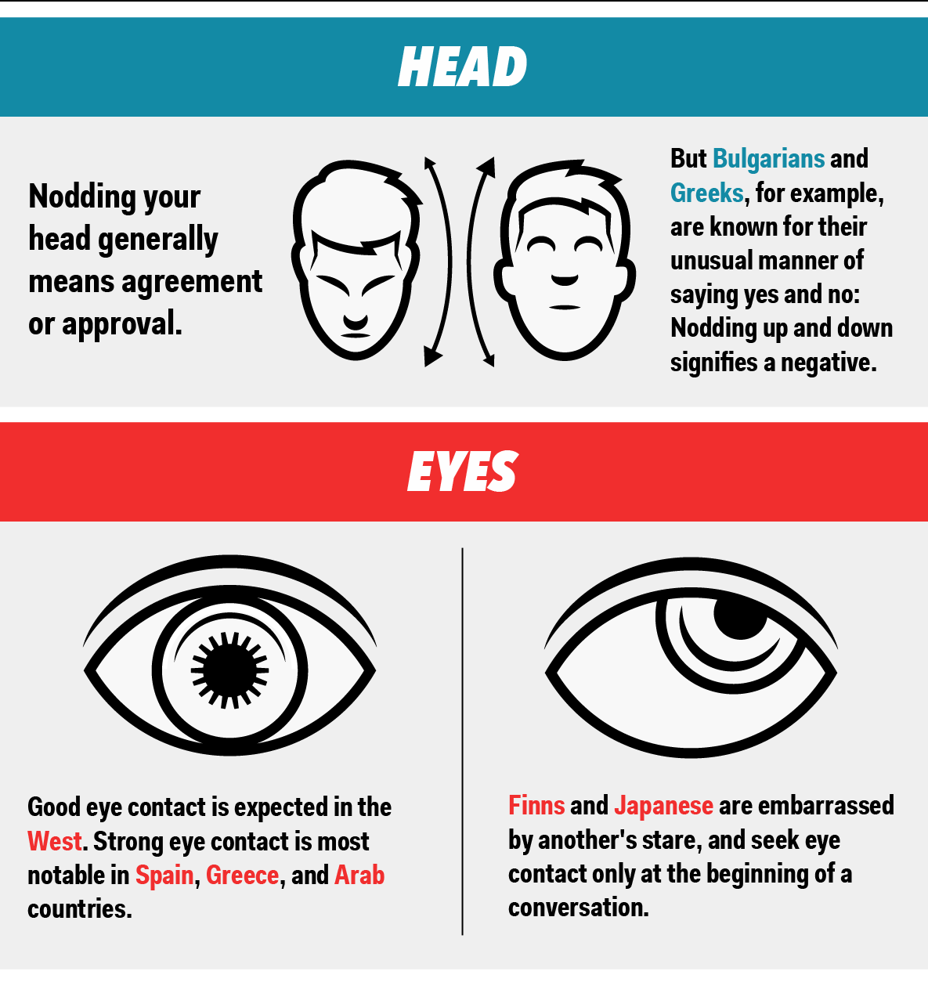
KINESICS ACROSS
DIFFERENT CULTURES
Eye contact –
Eye contact can mean very different things around the world.
Hand & Head Gestures - Specific hand and head gestures can mean different things in different cultures

Slide 13


CONCULSION
People communicate in countless ways, but kinesics, or the study of body language, is a fascinating and useful field that can help us better understand and connect with others. By being aware of the subtle cues and signals that our bodies unconsciously give off, we can gain a deeper understanding of ourselves and others and build stronger, more authentic connections with the people around us.

Slide 14

R E F E R E N C E S
Kinesics
https://en.wikipedia.org/wiki/Kinesics
Kinesics: The Categories of Gesture
https://elizabethkuhnke.wordpress.com/2011/05/10/kinesics-the-categories-of-gesture/
Cultural Differences in Body Language
https://www.commisceo-global.com/blog/cultural-differences-in-body-language
Kinesics: Body Language and Gestures
https://psychologywriting.com/kinesics-body-language-and-gestures/
The Art and Science of Business Communication (4th ed.), Chaturvedi P.D and Mukesh Chaturvedi,Pearson Publication
Business Communication Today ( 10th ed.), Courtland L. Bovee, John V. Thill and Abha Chatterjee, Pearson Publication
Communication Principles for a Lifetime (6th ed.), Steven A. Beebe, Susan J. Beebe, Diana K. Ivy, Pearson Publication

